Slide 1
Glacier
Paper-Prototype
Team 16

Slide 2
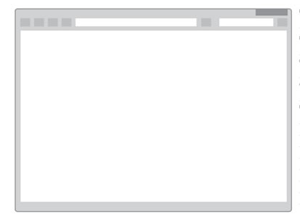

https://Glacier.io
Log In
Sign Up

Slide 3
User is asked to create an account if they don’t have one.
The benefit of having an account =
1) Allows user to track electricity usage over time.
2)Allows us to determine trends and patterns with bad or good energy consumption → allows us to provide better feedback.
https://Glacier.io
If you have an account, please select sign in.
If you don’t have an account, you can make one below.
Sign In
Sign Up
If you wish to proceed without the ability to track and compare your
energy consumption, please continue as guest.
Continue

Slide 4
https://Glacier.io
Please Sign in Below !
Username :
Sign in Screen for User.
Username will be the users email.
If user has forgotten password, can send an email reset link.
Password :
Sign In
Forgotten Password ?

Slide 5
https://Glacier.io
Please fill in the fields below ...
User may create an account, with an email and password.
Password is re-entered to ensure user is certain of what they have entered.
After Account is created, user is taken to Sign-In screen (slide 2)
Email (this will be your username)
Password
Re-Enter Password
Back
Create Account

Slide 6
https://Glacier.io
Please Enter Your Devices and your usage time on each device
Device Drop Down
Device Drop Down
Hours
Device Drop Down
Hours
Add Another Device
See Results
User chooses Device type from Drop Down menu, options being : Television, Mobile Phone, Games Console, Washing Machine, etc.
The time used will be entered in hours. I.E 2 hours, 1.5 hours etc

Slide 7
https://Glacier.io
First Draft of how Website will display Users results.
A column for the Power Usage of each device.
A column for the estimated Annual Cost.
And A column for our rating, via our relative rating system.

Slide 8
https://Glacier.io
Total 33
Our average is 20, this means you’re using 1.6 more electricity than the average person !
Perhaps you could :
. Drink more waters or juices, and try to make less coffees and teas.
. Try doing everyone's laundry together, rather than many small loads !
Average
You

